Slide 1
21.2 – World Climates & 21.3 – Climate Changes

Slide 2
Do Now
What is the Koppen Climate Classification System?
What are the natural processes that can change climate?

Slide 3
Do Now
What is the Koppen Climate Classification System?
The system that uses mean monthly and annual values of temperatures and precipitation to classify climates.
What are the natural processes that can change climate?
Volcanic Eruptions, Ocean Circulation, Solar Activity, and Earth’s Motions

Slide 4
Key Words
Rainshadows
Fluctuations
Drought
Contrast
Abruptly

Slide 5
Vocab Words
Koppen Climate Classification System
Wet Tropical Climate
Tropical Wet and Dry Climate
Humid Subtropical
Marine West Coast Climate
Dry-Summer Subtropical Climate
Subarctic Climate
Greenhouse Effect
Global Warming

Slide 6
Koppen Climate Classification System
Uses mean monthly and annual values of temperature and precipitation to classify climates.
Five principal groups of climates:
Humid Tropical
Humid Mid-Latitude
Dry
Polar
Highland

Slide 7
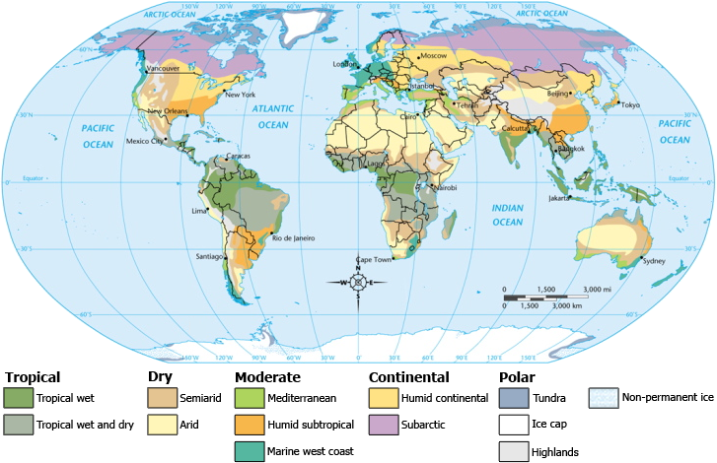

Slide 8
Humid Tropical
Climates without winters. Precipitation can exceed 200 cm per year.
Wet Tropical (rainforest)
High temperatures and much annual precipitation
Tropical Wet and Dry (savanna)
Have temperatures and precipitation similar to those in wet tropical, but experience periods of drought.

Slide 9
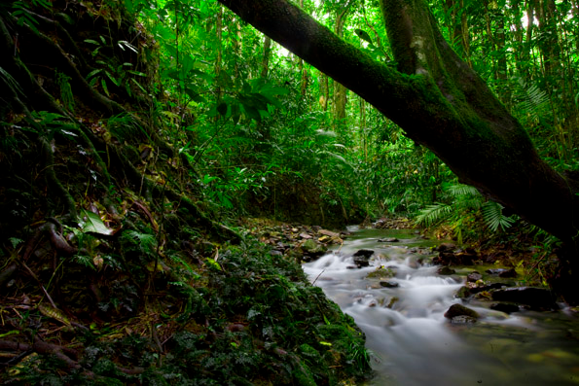
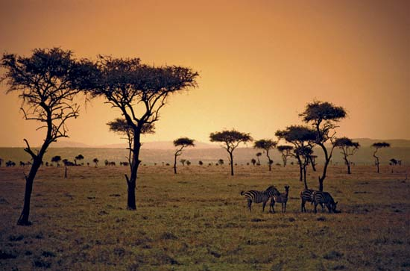

Slide 10
Humid Mid-Latitude
Climates without mild or severe winters
Humid Subtropical (mild winter)
Hot weather with mild winters.
Marine West Coast (mild winter)
Mild winters and cool summers.
Dry-Summer Subtropical (mild winter)
Also known as Mediterranean climate, Strong winter rainfall.
Subarctic (severe winter)
Summers are warm but short, winters are severe.

Slide 11
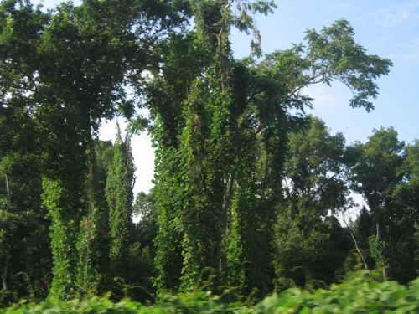
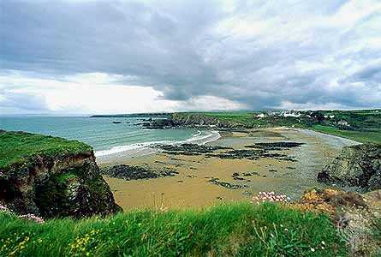
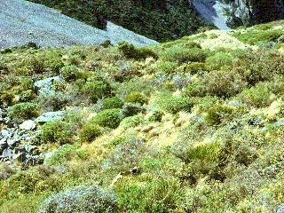
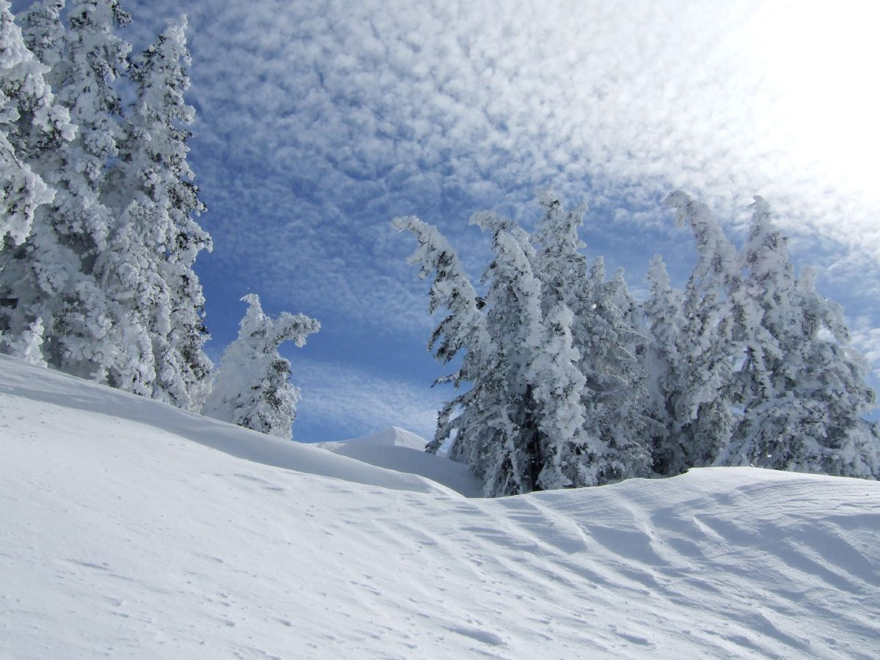

Slide 12
Dry Climate
The yearly precipitation is not as great as the potential loss of water by evaporation.
Desert (arid)
High rates of evaporation, no precipitation
Semi-arid Desert (steppe)
High rates of evaporation, little precipitation, borders arid deserts

Slide 13
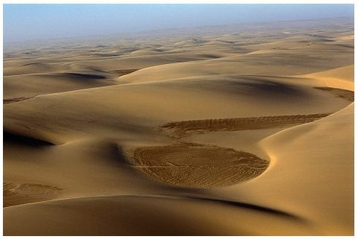
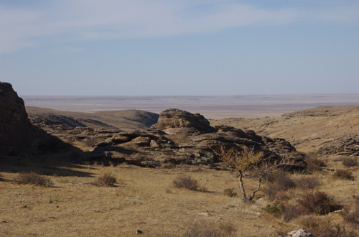

Slide 14
Polar Climates
Mean temperature of the warmest month is below 10 degrees Celsius
Tundra
Treeless region found in Northern Hemisphere.
Ice Cap
No single monthly mean temperature above 0 degrees Celsius. Permanent ice and snow.

Slide 15
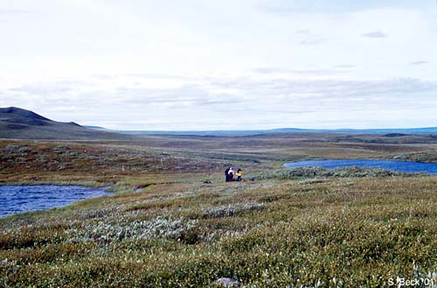
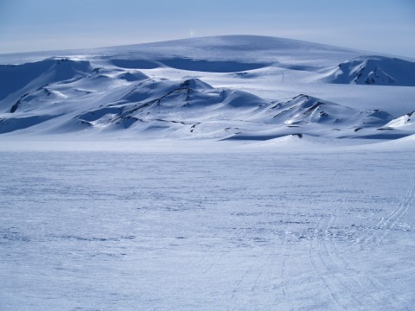

Slide 16
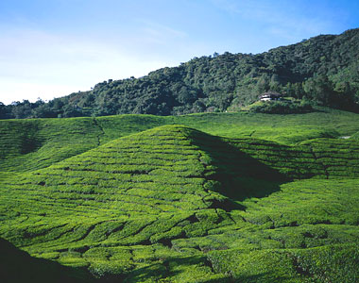
Highland Climates
Cooler and wetter climates than nearby areas at lower elevations.
Localized climates, they are much different from climates in surrounding areas.

Slide 17
Natural Processes That Change Climate
Like most conditions on Earth, climate is always changing.
Many natural processes can cause a climate to change.
Volcanic Eruptions
Ocean Circulation
Solar Activity
Earth Motions

Slide 18
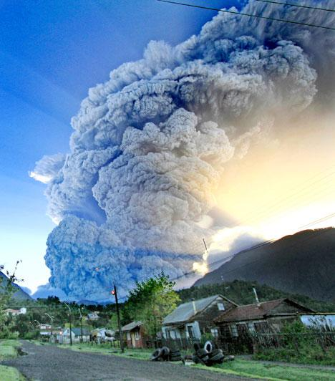
Volcanic Eruptions
Emit large volumes of ash and dust into Earth's atmosphere.
The presence of aerosols (volcanic ash, dust, and sulfur-based aerosols) in the air increases the amount of solar radiation that is reflected back into space.
Causes Earth's lower atmosphere to cool.

Slide 19
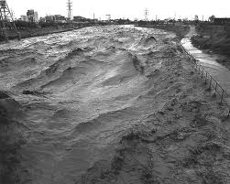
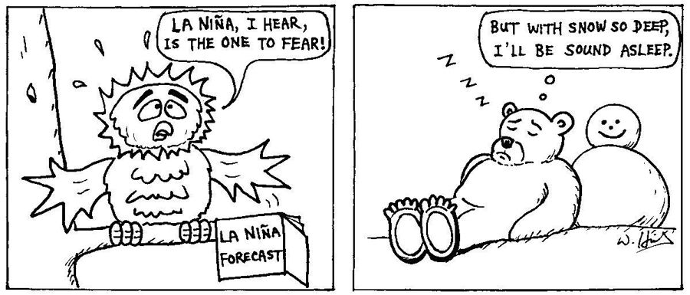
Ocean Circulation
Changes in ocean circulation can result in short-term climate fluctuations.
El Nino
La Nina
Affects
precipitation

Slide 20
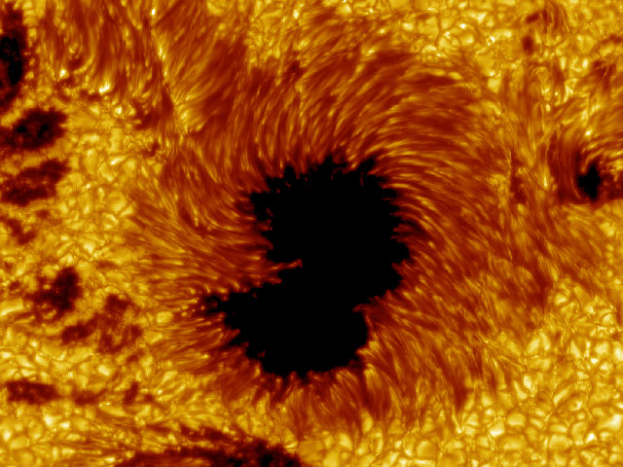
Solar Activity
The most studied hypotheses for the causes of climate change are based on changes in the output of solar energy.
Short-term affects, not long-term affects.
Sunspots

Slide 21
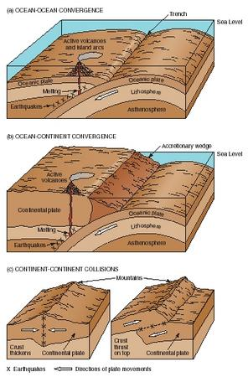
Earth Motions
A numbers of Earth motions are thought to have long-term affects of climates.
Tectonic plate movement
Uplifting of mountains
Earth's orbit
Earth's tilt

Slide 22
Human Impact on Climate Changes
The Greenhouse Effect
Natural warming of both Earth's lower atmosphere and Earth's surface
Global Warming
As a result of increases in carbon dioxide levels, as well as other greenhouse gases, global temperatures have increased.
Weather patterns will changes as a result.

Slide 23
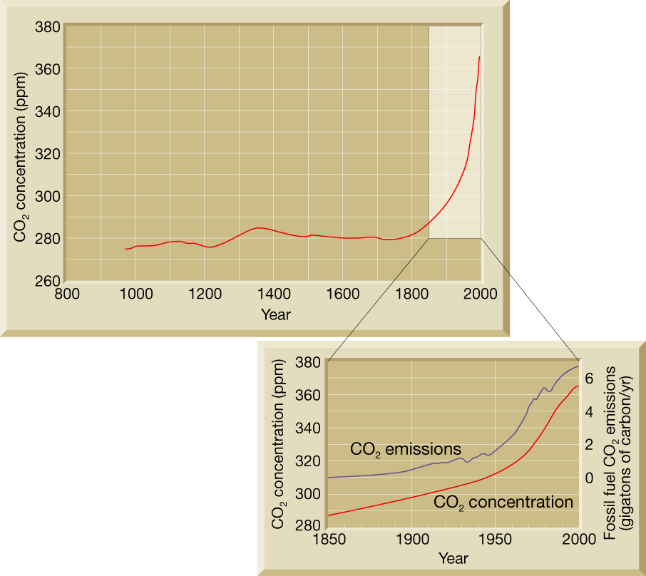
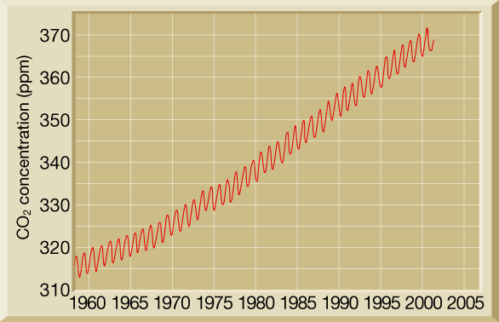

Slide 24
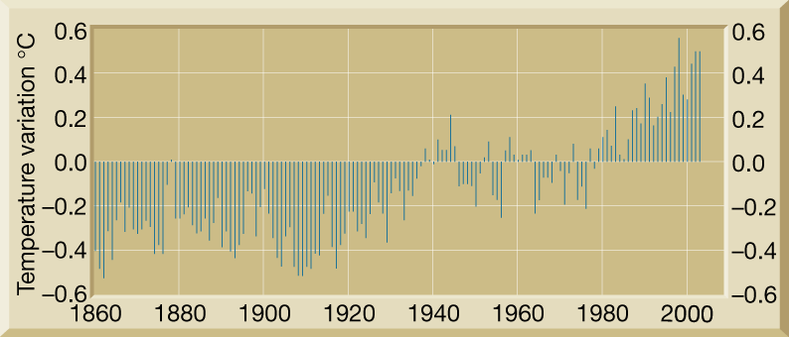

Slide 25
Climate Project Time!

